Slide 1
B.Tech Integrated Mid-Term Presentation
A.Y. 2021-2022 Project Title: Disease Detection System using Machine Learning
Presented by: Vaibhav Raheja (C056)
Viraj Shah (C064)
Mayank Shetty (C075)
Purav Patel (C098)
Under The Guidance of: Prof. Manisha Tiwari

Slide 2
Roadmap
Introduction
Problem Statement
Literature Review
Proposed System
Proposed Algorithm
Architecture Diagram
Implementation
Implementation Schedule
Plan for Next Semester
References

Slide 3

Machine Learning in Disease Detection
Machine learning (ML) is the study of computer algorithms that improve automatically through experience and by the use of data.
It is seen as a part of Artificial Intelligence (AI).
Machine learning algorithms build a model based on sample data, to make decisions without any explicit programming.

Slide 4
Problem Statement
Chronic diseases last for a period of 1 year or more, and are caused by environmental, genetic, and physiological factors.
Cardiovascular Disease is the leading cause of death globally, claiming an estimated 17.9 million lives in 2019 alone.
Respiratory disease, diabetes, and kidney diseases are included in the global list of top ten leading causes of death.
Early diagnosis of chronic diseases may reduce several casualties.

Slide 5
Literature Review
Link for Literature Review

Slide 6
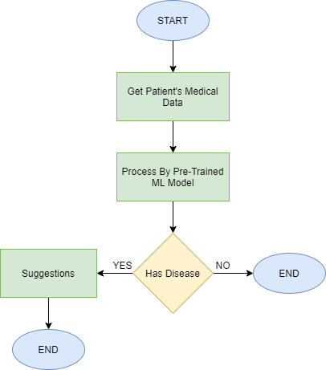
Proposed System
Chronic Disease | Dataset
Chronic Kidney Disease | UCI Chronic Kidney Disease Dataset
Diabetes | PIMA Indians Diabetes Database
Heart Ailments | UCI Heart Disease Dataset
Pneumonia | Dataset for OCT & Chest X Ray, University of California, San Diego,

Slide 7
Proposed Algorithm
Algorithm for machine learning for Chronic Kidney Disease Detection
Logistic Regression
Random Forest
Algorithm for machine learning for Diabetes Detection:
K-Nearest Neighbour
Logistic Regression

Slide 8
Proposed Algorithm
Algorithm for machine learning for Heart Disease Detection
Decision Tree
Random Forest Regression
Algorithm for machine learning for Pneumonia
Convolutional Neural Network
Support Vector Machine (SVM)

Slide 9
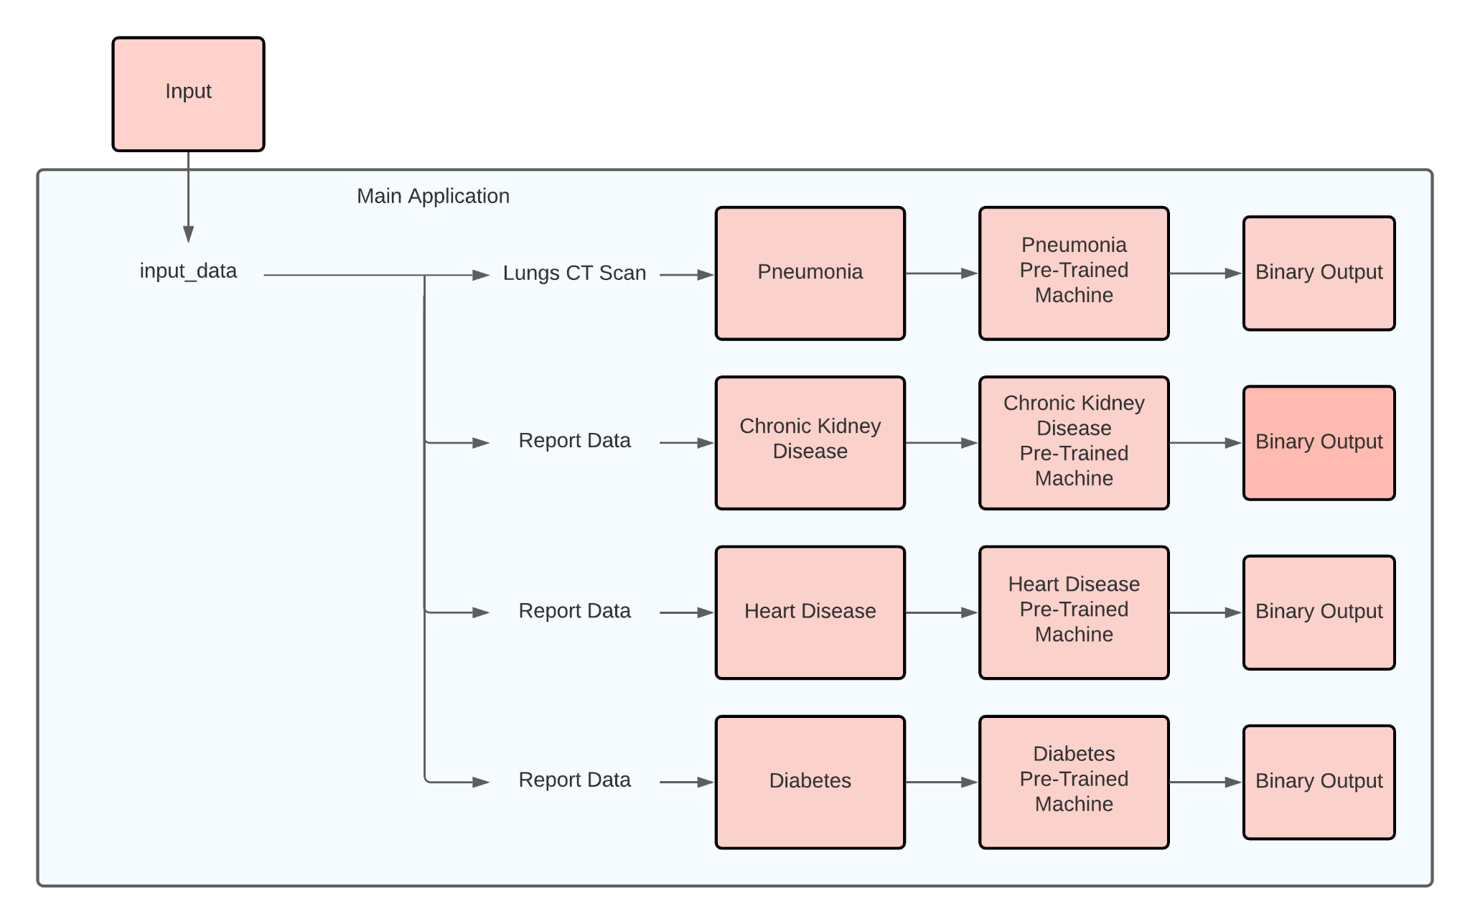
Architecture Diagram

Slide 10
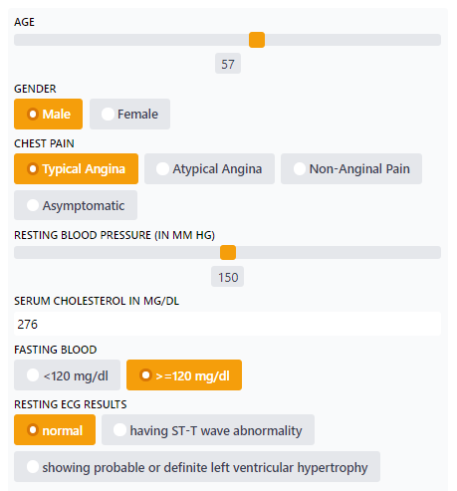
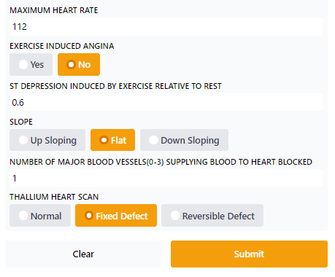

Implementation

Slide 11
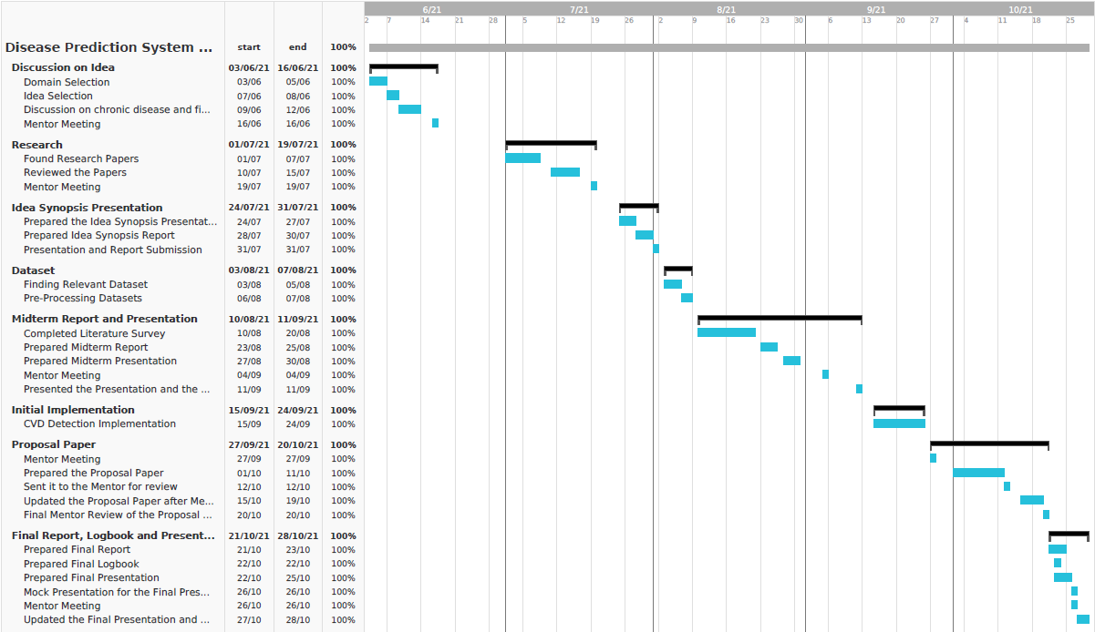
Implementation Schedule

Slide 12
Plan for Next Semester
For the next semester, we plan to start with the implementation of classifier models for the remaining chronic diseases of the proposed disease detection expert system. Once we have the models ready, we will look into hyperparameter tuning for each of the models. Achieving a high accuracy for each classified model is our goal.
Once the individual models are ready, we will start working on the GUI for our expert system. After working with the GUI, we will be working on collaborating all of the machine learning models into one unified expert system, which will help us accomplish our goal for the project.
After collaborating the models together, there will be a testing phase to check the accuracy of each model again as well as check the system requirements of our deployed model.
Notes:
Maam for we plan to start with the implementation of classifier models for the remaining chronic diseases of the proposed system
Once we have the models ready,we will start working on the GUI after working with the GUI, we will be working on collaborating all of the machine learning models into one unified system
After collaborating the models together, there will be a testing phase to check the accuracy of each model and check the system requirements of our deployed model.

Slide 13
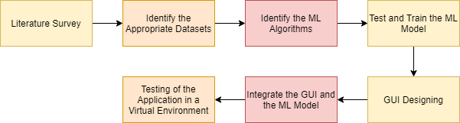
Plan of Action

Slide 14
References
[1] J. J. Khanam, S. Y. Foo, “A comparison of machine learning algorithms for diabetes prediction”, ICT Express (Feb. 2021), 2021, doi: 10.1016/J.ICTE.2021.02.004.
[2] D. Shetty, K. Rit, S. Shaikh and N. Patil, "Diabetes disease prediction using data mining," 2017 International Conference on Innovations in Information, Embedded and Communication Systems (ICIIECS), 2017, pp. 1-5, doi: 10.1109/ICIIECS.2017.8276012.
[3] A. Mujumdar, V. Vaidehi, “Diabetes Prediction using Machine Learning Algorithms”, Procedia Computer Science, Volume 165, 2019, pp. 292-299, doi: 10.1016/J.PROCS.2020.01.047.
[4] S. K. Dey, A. Hossain and M. M. Rahman, "Implementation of a Web Application to Predict Diabetes Disease: An Approach Using Machine Learning Algorithm," 2018 21st International Conference of Computer and Information Technology (ICCIT), 2018, pp. 1-5, doi: 10.1109/ICCITECHN.2018.8631968.
[5] M. Kavitha, G. Gnaneswar, R. Dinesh, Y. R. Sai and R. S. Suraj, "Heart Disease Prediction using Hybrid Machine Learning Model," 2021 6th International Conference on Inventive Computation Technologies (ICICT), 2021, pp. 1329-1333, doi: 10.1109/ICICT50816.2021.9358597.
[6] F. Alotaibi, “Implementation of Machine Learning Model to Predict Heart Failure Disease”, International Journal of Advanced Computer Science and Applications (IJACSA), 10(6), 2019, doi: 10.14569/IJACSA.2019.0100637.
[7] J. Qin, L. Chen, Y. Liu, C. Liu, C. Feng and B. Chen, "A Machine Learning Methodology for Diagnosing Chronic Kidney Disease," in IEEE Access, vol. 8, pp. 20991-21002, 2020, doi: 10.1109/ACCESS.2019.2963053.
[8] R. Gupta, N. Koli, N. Mahor and N. Tejashri, "Performance Analysis of Machine Learning Classifier for Predicting Chronic Kidney Disease," 2020 International Conference for Emerging Technology (INCET), 2020, pp. 1-4, doi: 10.1109/INCET49848.2020.9154147.
[9] F. M. Javed Mehedi Shamrat, P. Ghosh, M. H. Sadek, M. A. Kazi and S. Shultana, "Implementation of Machine Learning Algorithms to Detect the Prognosis Rate of Kidney Disease," 2020 IEEE International Conference for Innovation in Technology (INOCON), 2020, pp. 1-7, doi: 10.1109/INOCON50539.2020.9298026.
[10] D. Varshni, K. Thakral, L. Agarwal, R. Nijhawan and A. Mittal, "Pneumonia Detection Using CNN based Feature Extraction," 2019 IEEE International Conference on Electrical, Computer and Communication Technologies (ICECCT), 2019, pp. 1-7, doi: 10.1109/ICECCT.2019.8869364. [11] A. Sharma, M. Negi, A. Goyal, R. Jain and P. Nagrath, “Detection of Pneumonia using ML & DL in Python.”, IOP Conference Series: Materials Science and Engineering 1022, 2021, doi: 10.1088/1757-899X/1022/1/012066.

